Slide 1
Wireless Hacking
Getting onto a network, then what to do once you get there

Slide 2

What Makes Wireless Special?
Clients on a wired network vs wireless
Analogy: people with blindfolds
Monitor mode vs Promiscuous
How encryption factors in

Slide 3

WEP Cracking
The different types of encryption
WPS
Why WEP is so vulnerable
Aircrack

Slide 4

ARP spoofing
You gained access, now what?
Blindfolded people analogy
MITM attack
SSL strip
note: no need for monitor mode

Slide 5
STOP
Demo time

Slide 6
Networking
Hack Night 2015

Slide 7

Communicating
[4]
Notes:
People talk in different languages, usually a translator
languages: protocols

Slide 8
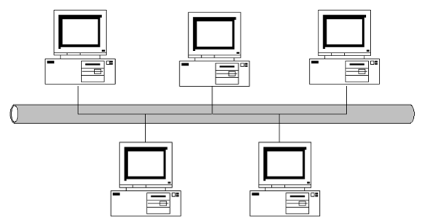
Sending and Receiving
[1]
Notes:
communication between devices
sending and receiving
making sure all of the message is received/sent
have to keep track

Slide 9

Help Desk
[5]
Notes:
Where to do if need to find an area?

Slide 10
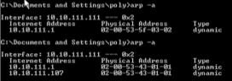
ARP Tables, MAC address, IP Address
Notes:
keeping track
mac address
media access control address
12 hex digits
physical address of device
can be changed
ip address
internet protocol
temp identifier
can change
assigned once join a network; Dynamic Host Configuation Protocol
IPv4 & IPv6
IPv4: 4 0-255’s separated by dots
IPv6: 8 0000-FFFF’s separated by colons
arp tables
address resolution protocol
keeps track of IP & MAC

Slide 11

Packets
[2]
Notes:
Packet
data that is sent/received
has src, dst, ipv4/6 etc...

Slide 12

TCP vs UDP
[3]
Notes:
more protocol
tcp
transmission control protocol
ensures every packet is sent in its entirety and in order
webpages
udp
user datagram protocol
does not have to be in order
does not have to receive all packets
good enough
media streaming

Slide 13
DNS
https://howdns.works/
Domain to IP address: nslookup ebay.com
Ping/Pong: ping google.com
Following: tracert google.com
Notes:
dns
translates domains to ip addresses
tells where to connect
telephone book; names are easy, numbers are hard
nslookup website.com
authoritative comes from legit dns
non authoritative might come from isp/someone that does not belong to website’s nameservers/cache
dns cache is just the local dns storing ips so it won’t have to look up the ip address every time and it’d be faster
if address changes before stored into cache, 404
tracert: example of path to connect to a site
ping: poke, just to see if there and responsive

Slide 14
Tools
Google Chrome Developer
Network
Wireshark
Right click > Follow TCP Stream
File > Export Objects > HTTP
Using the filter
Notes:
Show Network of Chrome Developer using pusheen.com
get requests; objects for page
post request; login
Show pusheen in wireshark traffic
requests
loading resources for page
GET/POST
get in URL
post not
either way is still changable, can use burp to change post requests
http status codes
200 ok
201 post
301 moved, should relink
404 not found
generally
4XX you dun goofed
5XX server dun goofed

Slide 15
Exercise: picoCTF 2013
https://www.cloudshark.org/captures/f0741cdfee53
What is the author of the thing that this person is searching for?
Notes:
picoCTF2013
https://www.cloudshark.org/captures/f0741cdfee53?filter=http
HTTP: author the the thing they’re looking for
Smasking the Stack for Fun and Profit
Aleph One
http
browser to people
code to people
requests to get resources to load page

Slide 16
Exercise: CSAW 2012
http://shell-storm.org/repo/CTF/CSAW-2012/Networking/100/
Hints:
What is the pcap file called?
What protocols are there within the pcap file?
Notes:
CSAW2012
http://shell-storm.org/repo/CTF/CSAW-2012/Networking/
100
What is the password?
follow tcp stream
welcome to 1969
200
What is the party password?
http

Slide 17
Homework
The rest of the Networking challenges of CSAW 2012
http://shell-storm.org/repo/CTF/CSAW-2012/Networking/

Slide 18
Sauces
[1]: http://csawgirls.isis.poly.edu/2015ppts/1_Networks_Pt1_Naming.pptx
[2] & [3]: http://www.chriswrites.com/thetheory-behind-building-multiplayer-ios-apps/
[4]: http://busyevent.com/wp-content/uploads/2013/03/talking.jpg

